Slide 1
Introduction to Financial Aid
Cora Moretta
The University of Akron
Office of Student Financial Aid

Slide 2
What is Financial Aid?
Financial Aid is a broad group of funding sources that assists students in meeting the cost of attending college and can include grants, scholarships, the work-study program, and student loans.

Slide 3
Federal Aid
Grants (free money)
Federal Pell Grant
Supplemental Educational Opportunity Grant (SEOG)
TEACH Grant
Federal Work-Study
Part-time employment opportunities for students with financial need. Funds earned are paid directly to the student for educational expenses.

Slide 4
State Aid
The Ohio Department of Higher Education
Ohio War Orphans Scholarship
Ohio Safety Officers College Memorial Fund
Ohio College Opportunity Grant
www.ohiohighered.org

Slide 5
Scholarships
Universities and Colleges
High school counselors
Private foundations, businesses, charitable organizations
Civic organizations, employers, credit unions
Scholarship sites
- www.fastweb.com
- www.scholarships.com
- www.collegenowgc.org

Slide 6
Federal Direct Student Loans
Subsidized Direct Loan
Unsubsidized Direct Loan
Interest free during periods of at least half-time enrollment
Six-month grace period before repayment begins
Current interest rate when repayment begins is 5.5%
Student is the borrower and begins repaying after graduating or leaving college.
Accrues interest during periods of enrollment
Six-month grace period before repayment begins
Current interest rate is 5.5%
Student is the borrower and begins repaying after graduating or leaving college.

Slide 7
What if I don’t receive enough aid?
Payment Plans
529 College Savings Plans
Private Educational Loans
Employment
Appeal for a special circumstance
Appeal for additional aid

Slide 8
Parent Loans
Parent Loan for Undergraduate Students (PLUS)
Parent is the borrower—not the student
Current Interest rate is 8.05%
Interest begins accruing as funds are disbursed
May choose to defer payments while student is in school
May have remaining funds (after school charges are paid) sent to the student for other educational expenses (books, supplies, transportation, etc.)
Credit-based, may use an endorser if initially denied
If parent is ineligible, student will have additional eligibility from the Unsubsidized Direct Loan

Slide 9
How Do I Apply for Financial Aid?
The Free Application for Federal Student Aid (FAFSA) at www.studentaid.gov
This application is used for federal and state grants, federal work-study, federal student and parent loans.
The CSS Profile at www.cssprofile.collegeboard.org
This application is used for institutional grants and scholarships and allows the school to take a closer look at your financial situation, assets, etc.
Not all schools require this application, check their website.

Slide 10
When Do I Apply?
The FAFSA will be available December 31, 2023.
The Free Application for Federal Student Aid (FAFSA) is undergoing the most significant changes in the past 40 years, because of the FAFSA Simplification Act of 2020.
The Act was created to help streamline the FAFSA and make it easier for families to apply and receive financial aid.

Slide 11
What is Changing?
The number of questions has reduced from 108 to 64 and depending on your answers, some won’t be asked!
Tax information will be loaded directly from your federal income tax return with the IRS!
Students can now list up to 20 schools.

Slide 12
Other Changes
Anyone sharing information on the FAFSA will be called a contributor, not a parent or a spouse in the case of independent students.
The Student Aid Index (SAI) will replace the previous Expected Family Contribution (EFC) and can be as low as -$1,500.
The Direct Data Exchange with the IRS is the process of linking tax return information to the FAFSA. All contributors to the FAFSA must give consent, even if they don’t file a return.

Slide 13
What is Changing?
A change in the federal methodology will now exclude the number of children in college from the calculation (though the question remains on the form), meaning families will no longer be able to distribute their expected family contribution between them.
Small businesses and family farms must be reported as assets
Child support received will now be considered an asset
Students whose parents are divorced, and not remarried, will report the income for the parent who provided the majority of financial support, NOT the parent that they lived with for the past twelve months.

Slide 14
Everyone Needs an FSA ID!
This will serve as your legal signature on federal financial aid documents and the FAFSA.
Go to www.studentaid.gov.
Click on Create Account and create an FSA ID (federal student aid ID) for student AND anyone who is contributing to the FAFSA.
You will need a permanent email and mobile-phone number.
Create your FSA ID now, don’t wait until December!

Slide 15
Application Process Flow
Complete the FAFSA
Government Processes Application
School receives FAFSA results
School requests any additional documents needed
Financial Aid Offer!
School determines your awards
You submit documents

Slide 16
Financial Aid Offer
Schools will likely begin sending financial aid offer letters in March due to the delayed FAFSA
Will arrive either by U.S. Mail to the student’s home or email to the student’s college or university assigned email address.
Award notifications are sent to students, not parents.
Offer will include estimated costs and all types of financial aid being offered to the student for the year (at that time).

Slide 17
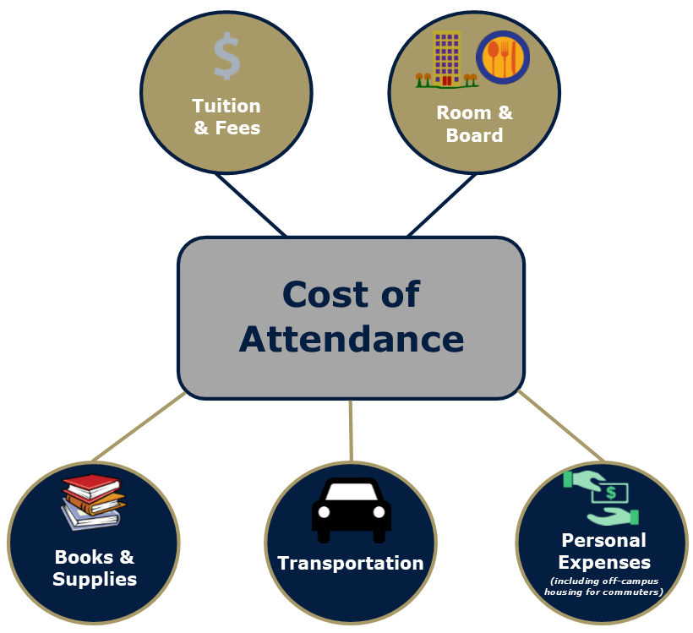

Slide 18
Sample Costs
Private Four-Year University
Tuition and Fees $36,850
Room and Board $12,796
Total $49,646
Public Four-Year University
Tuition and Fees $11,923
Room and Board $12,412
Total $24,335
Community College
Tuition and Fees $5,538

Slide 19
Reminders
Don’t pay to file the FAFSA or for scholarship info!
Read everything sent to you by the financial aid office.
Turn in requested documents in a timely manner.
Finalize everything in June/early July.
Call the financial aid office if you have any questions.

